Slide 2
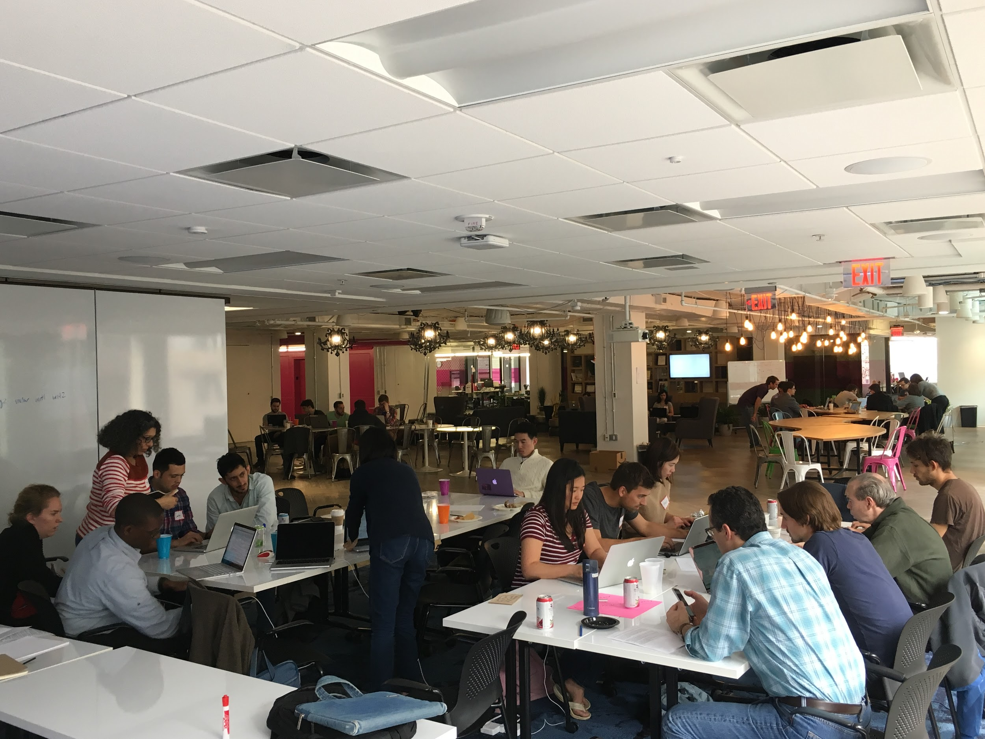

Thanks for coming to
the DataDive at Georgetown!

Slide 3

Thank you to our hosts!
Special thank you once again to:
Notes:
SPEAKER: William

Slide 4





A huge thank you to our project partners as well!!
Notes:
SPEAKER: Aimee

Slide 5
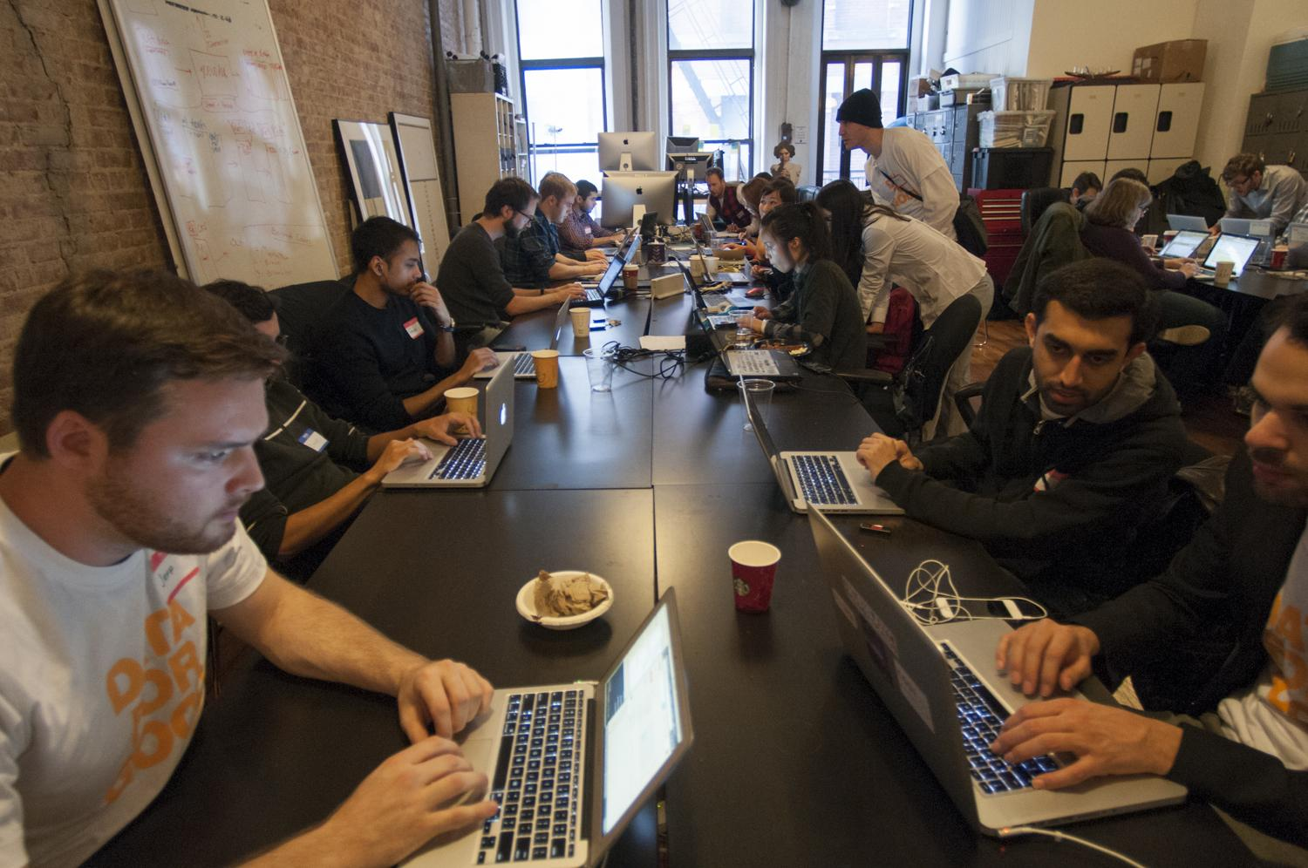
Thanks for being part of the DataKind Community
So, what did we do today? What did we learn? What’s next?
p
Notes:
SPEAKER: William
Datakind harnesses the power of data science in the service of humanity.
Mission-driven organizations often collect data, but often lack the capacity to gain insights and build their capacity from that data.
We create teams of pro bono data scientists who work together with these organizations to understand the need, find a solution, and collaborate to tackle the problem with data science.
Organizations get a solution they can use along with an education in data science, our volunteers get real world experience and the warm fuzzies, and we all get to live in a better world.
Which is to say, we’re in a movement together: data for good.

Slide 6
Partner Org Rep: Rose Data Ambassador: Sneha, Katie, Taylor

Slide 7

Goals for today (in order of importance)
Exploring and cleaning data
Skills: Data wrangling (R or Python, any experience)
Data visualization and dashboarding
Skills: Data wrangling, cleaning, visualizing (some experience is useful but not required)
Sentiment analysis of open ended questions
Skills: Natural Language Processing (R or Python, some experience is useful)
Notes:
SPEAKER: <Sneha>

Slide 8
Basic Breakdown of Data
Notes:
SPEAKER: <Sneha>

Slide 9
Employment - Kate
Notes:
SPEAKER: <Sneha>

Slide 10
Notes:
SPEAKER: <Sneha>

Slide 11

Partner Org Rep:
Charlyn
Data Ambassadors:
Alex, Juan, Glenn
Notes:
SPEAKER: <name>

Slide 12
DataDive Goals
SWT Dataset Exploration
Analyze YoY growth in participants served, participants served by event type, and number/type of service partners.
Summarize demographic characteristics of participants.
Summarize participant workshop interests and post-workshop feedback.
Skills: Data wrangling, data visualization, Python (or R)
External Dataset Exploration
Identify publicly available data sources at the census block or other geographical levels that relate to mental health, financial instability, unemployment, racial wealth gap, etc.
Merge data sets into one master data set used to identify SWT target service areas
Identify other culturally relevant mental health and wellness service providers in Wards 7 and 8.
Skills: Data analysis, Python (or R), GIS, Time series
Notes:
SPEAKER: <name>

Slide 13
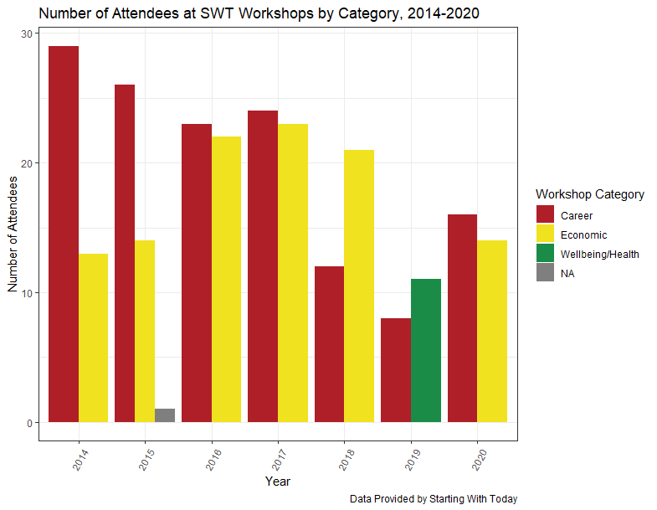
Exploratory Data Analysis
The number of workshop attendees ranged between around 40 in 2014 to 30 in 2020
The number of participants in career-related workshop has decreased over time, compared to economic-related workshops
Possibly influenced by external/community partnerships
Notes:
SPEAKER: <name>

Slide 14
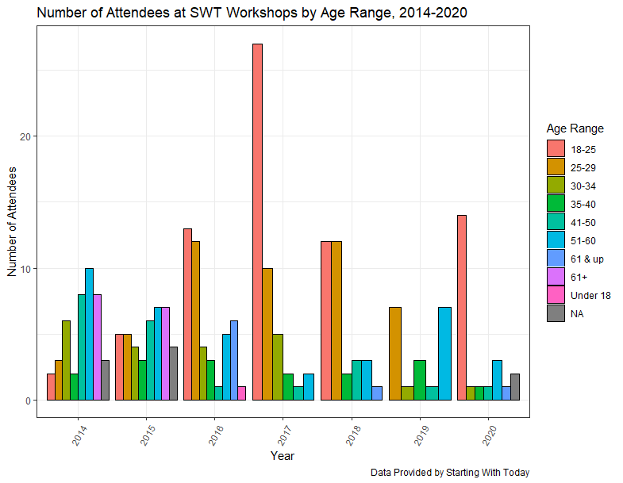
Exploratory Data Analysis
The number of workshop attendees has significantly variability in terms of participant age groups
Workshop participants’ ages ranged from under 18 to 61+ from 2014 to 2020
Trend suggests workshops are more commonly attended by younger people
Could also be affected by community partnerships
Notes:
SPEAKER: <name>

Slide 15
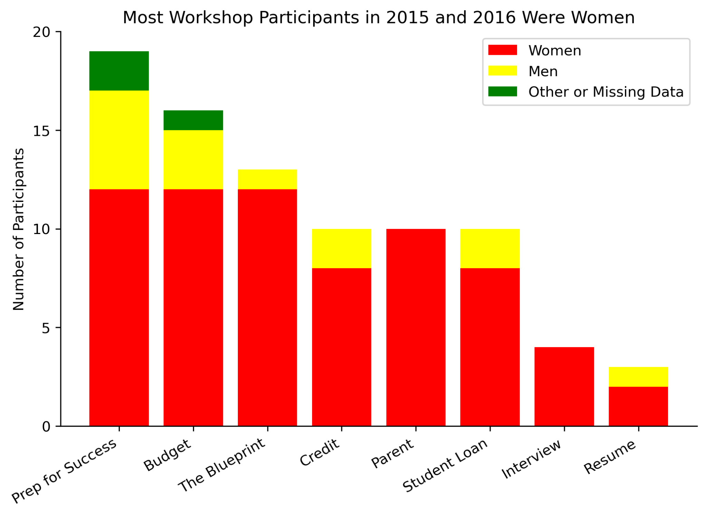
Exploratory Data Analysis
In 2015-16, the Prep for Success and Budget workshops attracted more male participants than other workshops
Participation for women was relatively consistent for all workshop types except Interview and Resume
These workshops had low attendance for all genders
Future analyses should compare this data to surveys from more recent years to establish or verify trends
Notes:
SPEAKER: <name>

Slide 16
External Data Sets Exploration
Our team explored the following data sets using APIs and CSV docs to identify the geographical areas at census block and tract levels that highlight the socio-economic factors of SWT’s target population
Data sets explored included:
Data Set | Source
Unemployment rates | American Community Survey (2020)
Depression rates | Center for Disease Control
Poverty rates, median household income, etc | American Community Survey (2021)
Number of non-profit service providers by service area and zip code | idealist.org
Notes:
SPEAKER: <name>

Slide 17
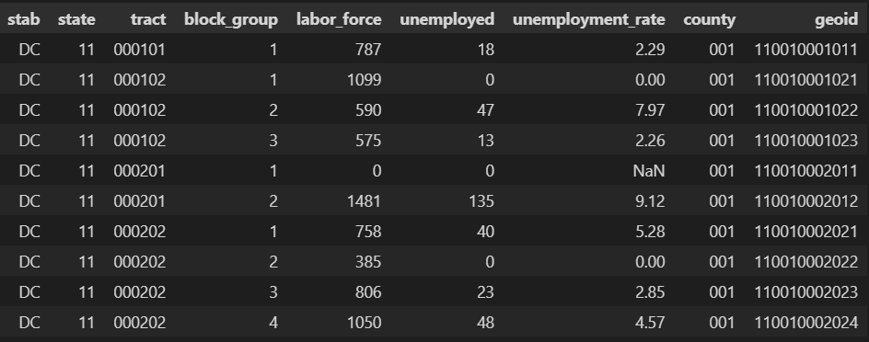
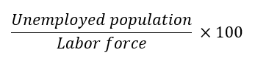
Unemployment Data
Tract: Census tracts are small, subdivisions of a county, each has a unique numeric code.
Block group: It is the smallest geographical unit for which the United States Census Bureau publishes sample data.
Unemployment rate:
Data source: The American Community Survey (ACS) 2020 Census Data
Geoid: state code + tract code + county code + block group code
Notes:
SPEAKER: <name>

Slide 18
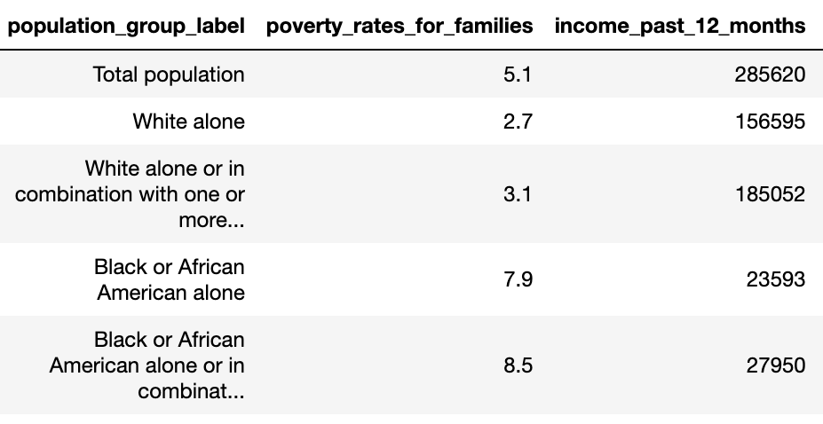
Income / Poverty Data
Using economic status to indicate inequities in mental health services…
Pull data via Census API
Poverty
Financial instability
Racial wealth gap
Notes:
SPEAKER: <name>

Slide 19
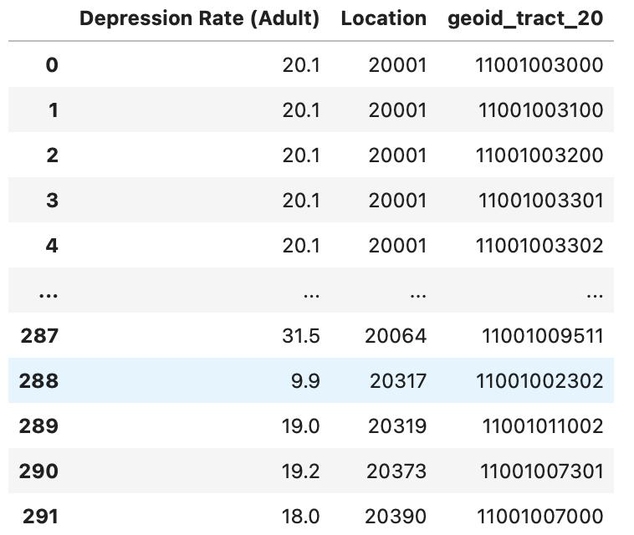
Mental Health Data
Depression rate is a strong indicator of the mental health situation of one community
The dataframe displays the depression rate census of adults in 2019, DC area.
Columns:
Depression Rate : percentage
Location: 5 digits ZIP code
Geoid_tract_20: 11 digits geoid code on the tract level
Notes:
SPEAKER: <name>

Slide 20
Next Steps
Provide recommendations for standardized data collection
Analyze/review data of # of participants served with SWT leadership
Defining outcomes measures and KPIs to track over time
Join data sets based on census block/tract level and generate needs score and visualize in a map; explore clustering methods
Webscrape data of mental health providers from idealist.org to identify areas in DMV region with few service providers
Notes:
SPEAKER: <name>

Slide 21
Partner Org Rep:
John Zoltner
Data Ambassadors:
Charlotte, Amy
Notes:
SPEAKER: Nicole and Frank

Slide 22

Track 1: Dataset Exploration (cleaning and organization)
Example Subtasks:
Create standardized list for categorical data (ex- look up table for administrative region names)
Identify column data types
Apply Humanitarian eXchange Language (HXL) to tables
Compare table present for multiple countries
Skills: Database, SQL, Critical reading/research, Data wrangling
Track 2: Prototyping Analyses and Visualizations
Example Subtasks:
Visualize data, including geospatially and/or temporally
Analyze health care facility availability v population
Look for correlations within and between datasets
Normalize variable by population
Build predictive models of time series
Skills: Database, SQL, Python (or R), GIS, Time series, Data analysis

Slide 23
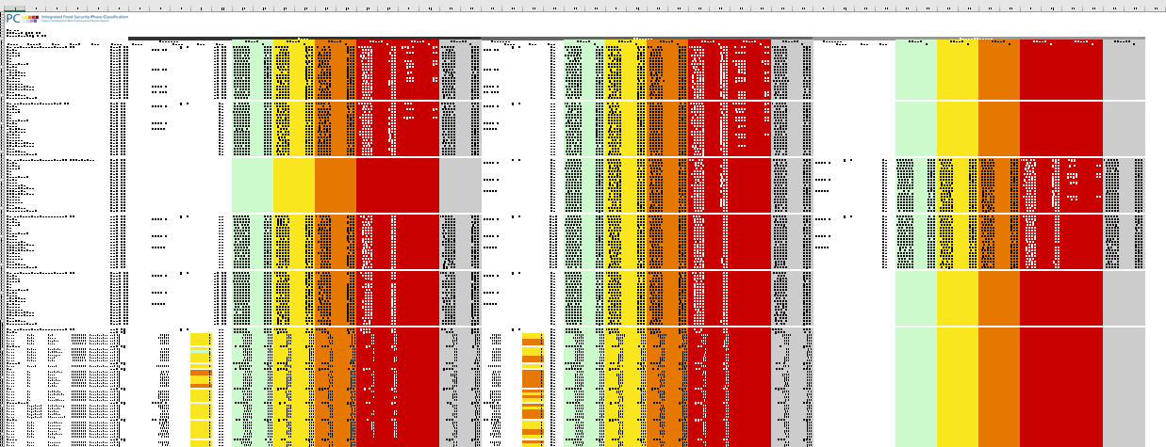
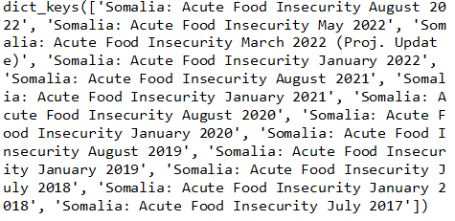
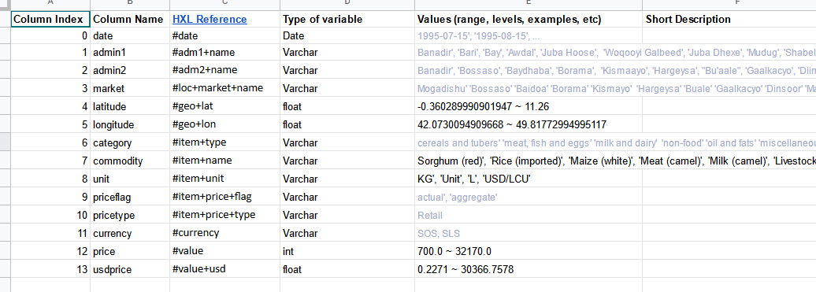
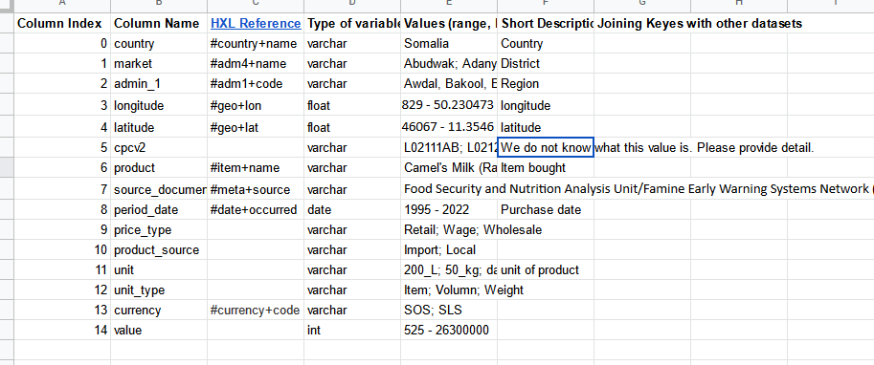
Track 1 Results: Data cleaning
Understand meaning of columns
Standardize tags for columns
Transfer xlsx to dataframe

Slide 24
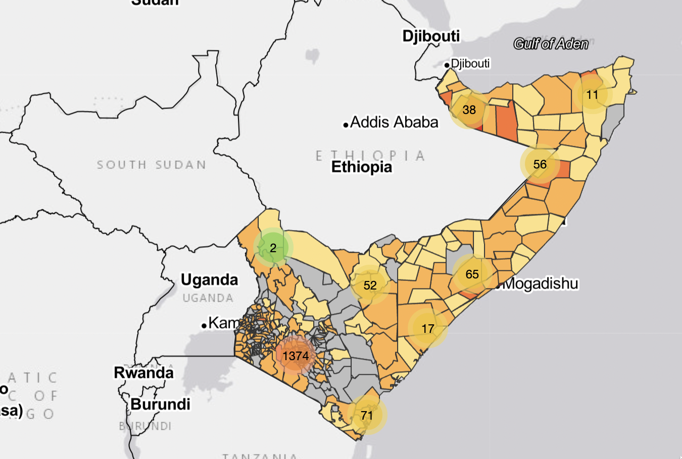
Track 2 Results: Maps
Health care facilities
https://rexarski.github.io/SaveTheChildren/

Slide 25
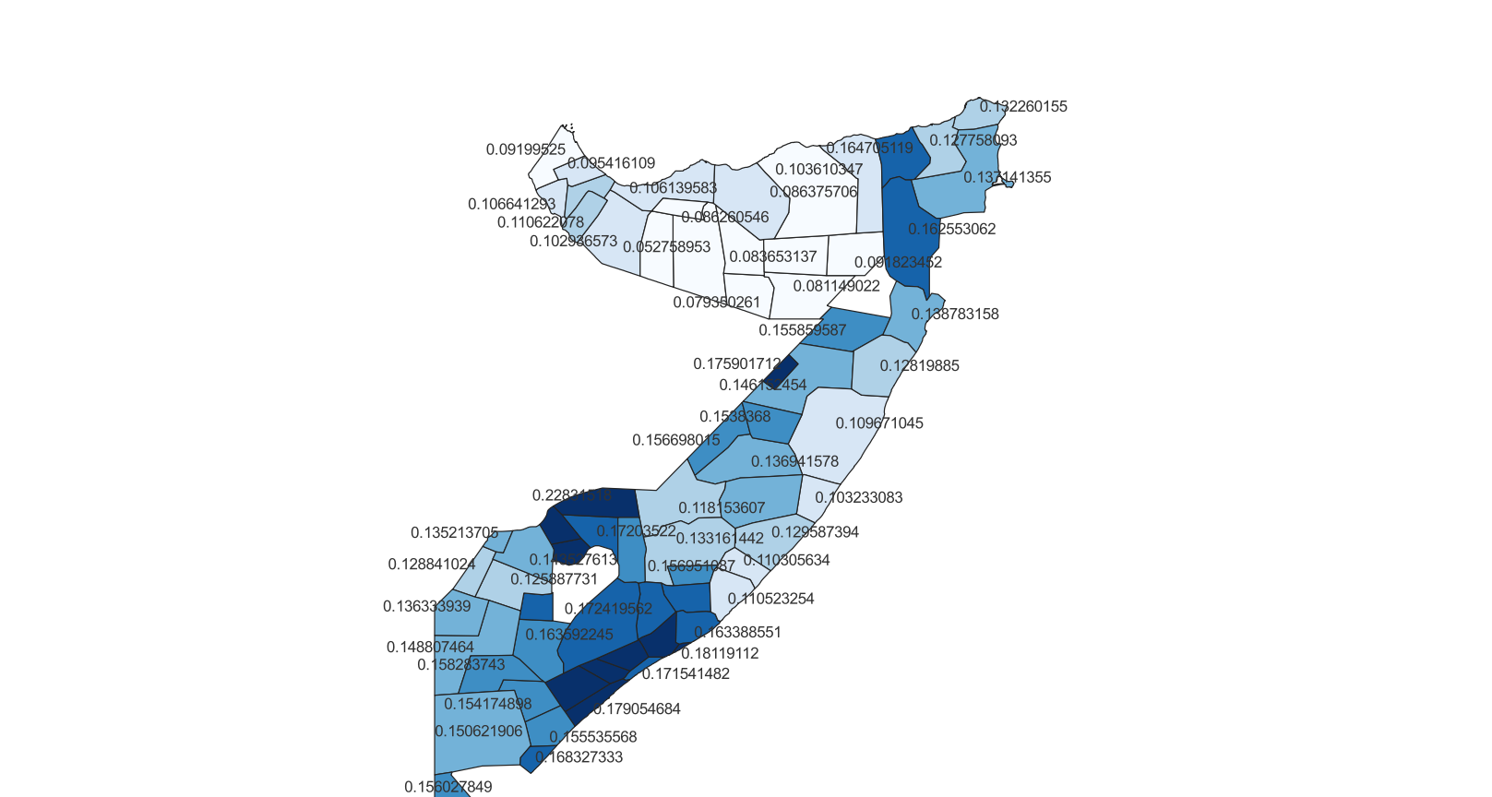
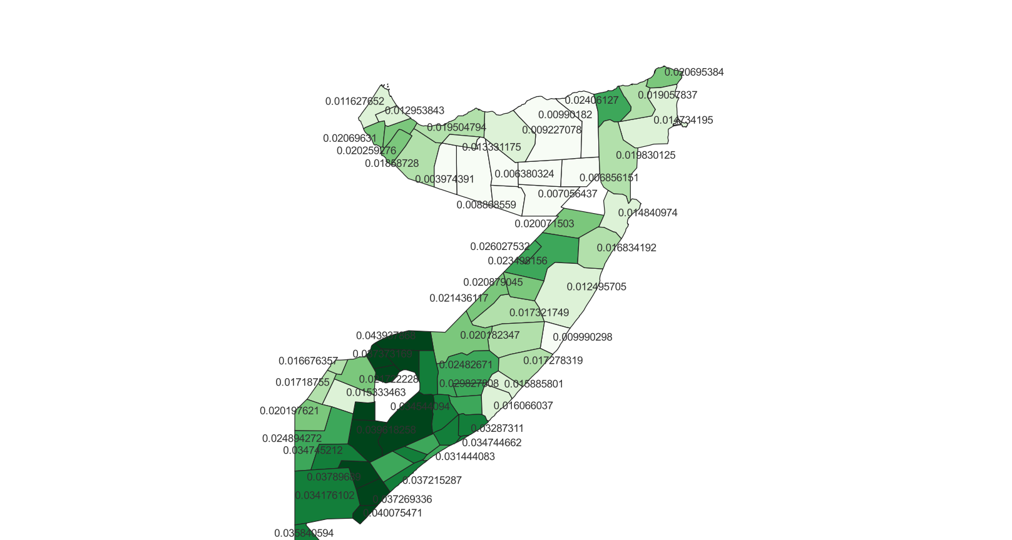
Track 2 Results: Maps
Merged geospatial data with malnutrition by region
Color indicates malnutrition index
Global Acute Malnutrition (blue)
Severe Acute Malnutrition (green)
Notes:
-merged geospatial data with malnutrition
-color indicates malnutrition index
prevalence, or proportion, of children ages 6-59 months in a given population considered severely acutely malnourished (SAM) or moderately acutely malnourished (MAM) based on their mid-upper arm circumference measurements.

Slide 26
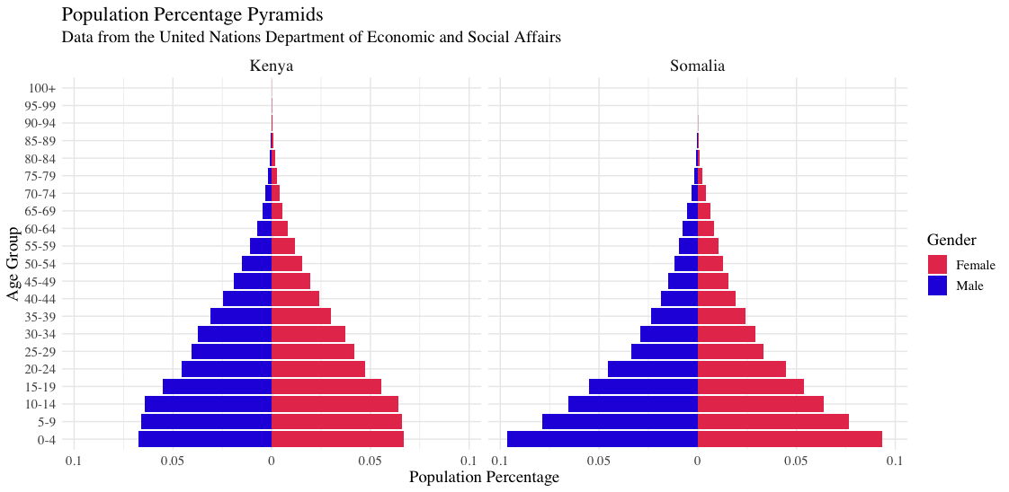
Track 2 Results: Population visualizations

Slide 27
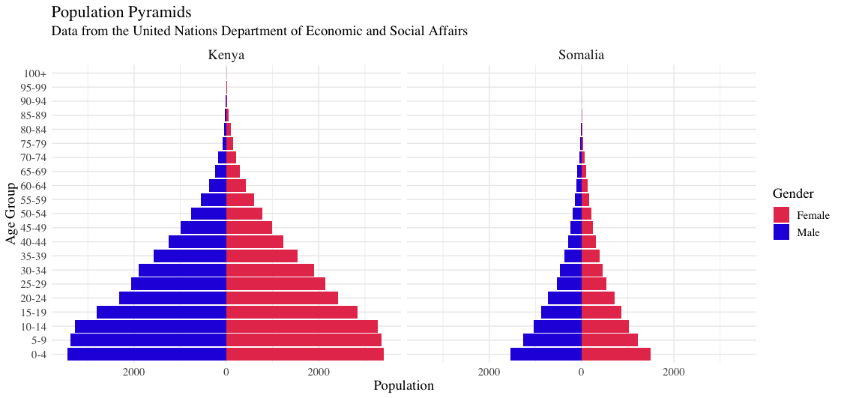

Slide 28
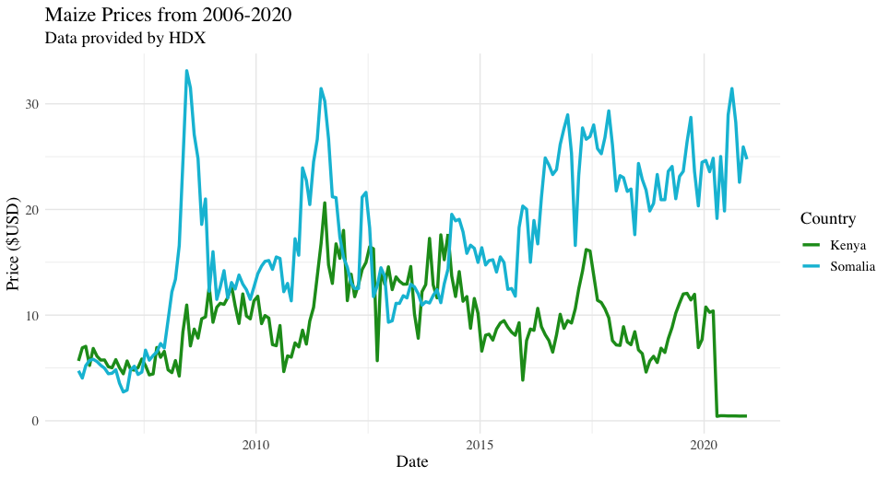
Track 2 Results: Time Series across countries

Slide 29
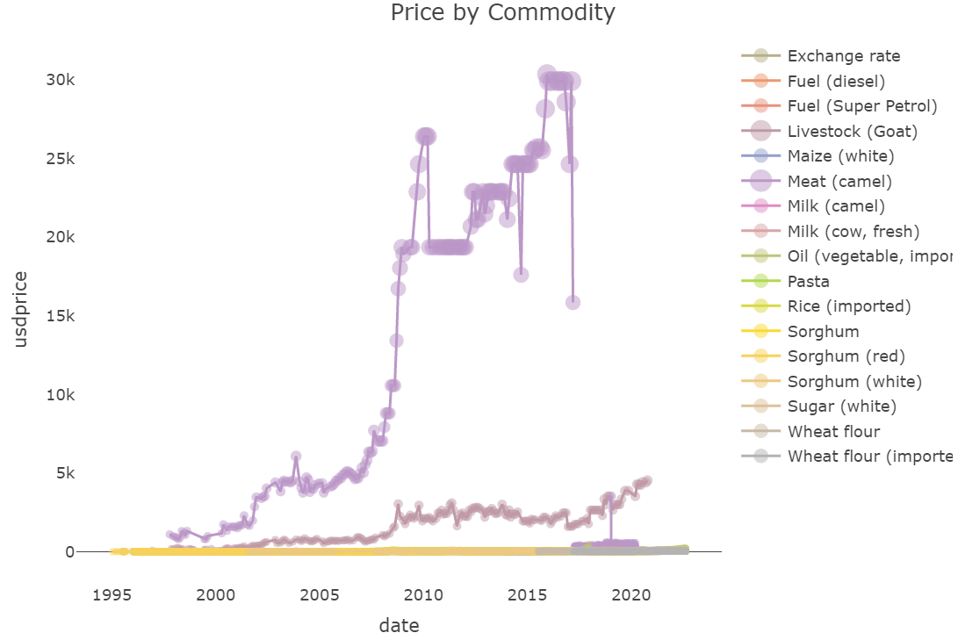
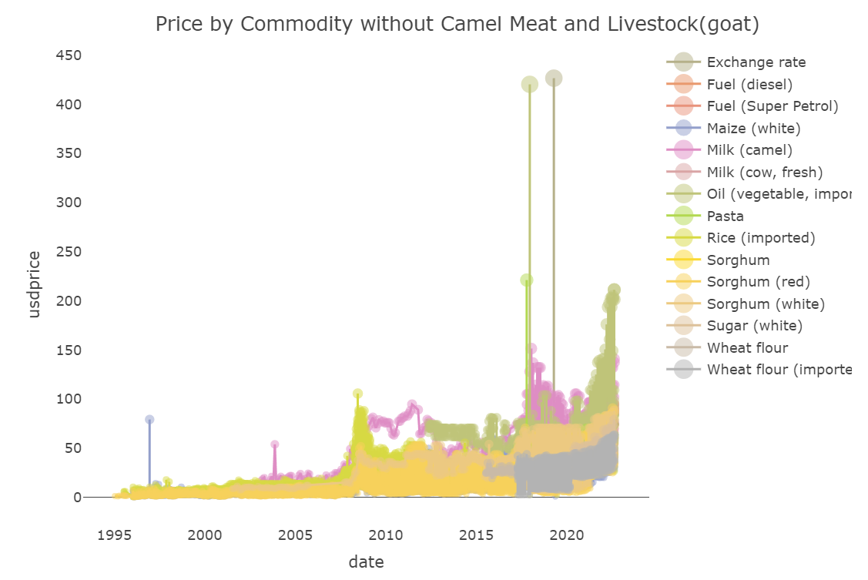
Track 2 Results: Time Series across Commodity

Slide 30
Lessons Learned:
Some tables are more accessible than others
Computation power important for geospatial analysis
Tables are very rich with information
Next Steps:
Finish database clean up
Implement clean-up into Azure ingestion process
Do similar analysis and visualization for humanitarian relief presence
Get feedback from Save the Children on directions

Slide 31
Partner Org Rep:
Ashley Barry
Data Ambassadors:
Chuck
Notes:
SPEAKER: Ashley and Chuck

Slide 32

Complex Data - lots of time spent understanding nuances
Then - Cleaning Cleaning Cleaning!
Also, Feature Engineering
Collapsing key attributes of many to one data into new features
Conditional logic to extract more meaningful factor columns from many rows
Notes:
SPEAKER: <name> Predicting success: Does the program make a difference? For who?

Slide 33
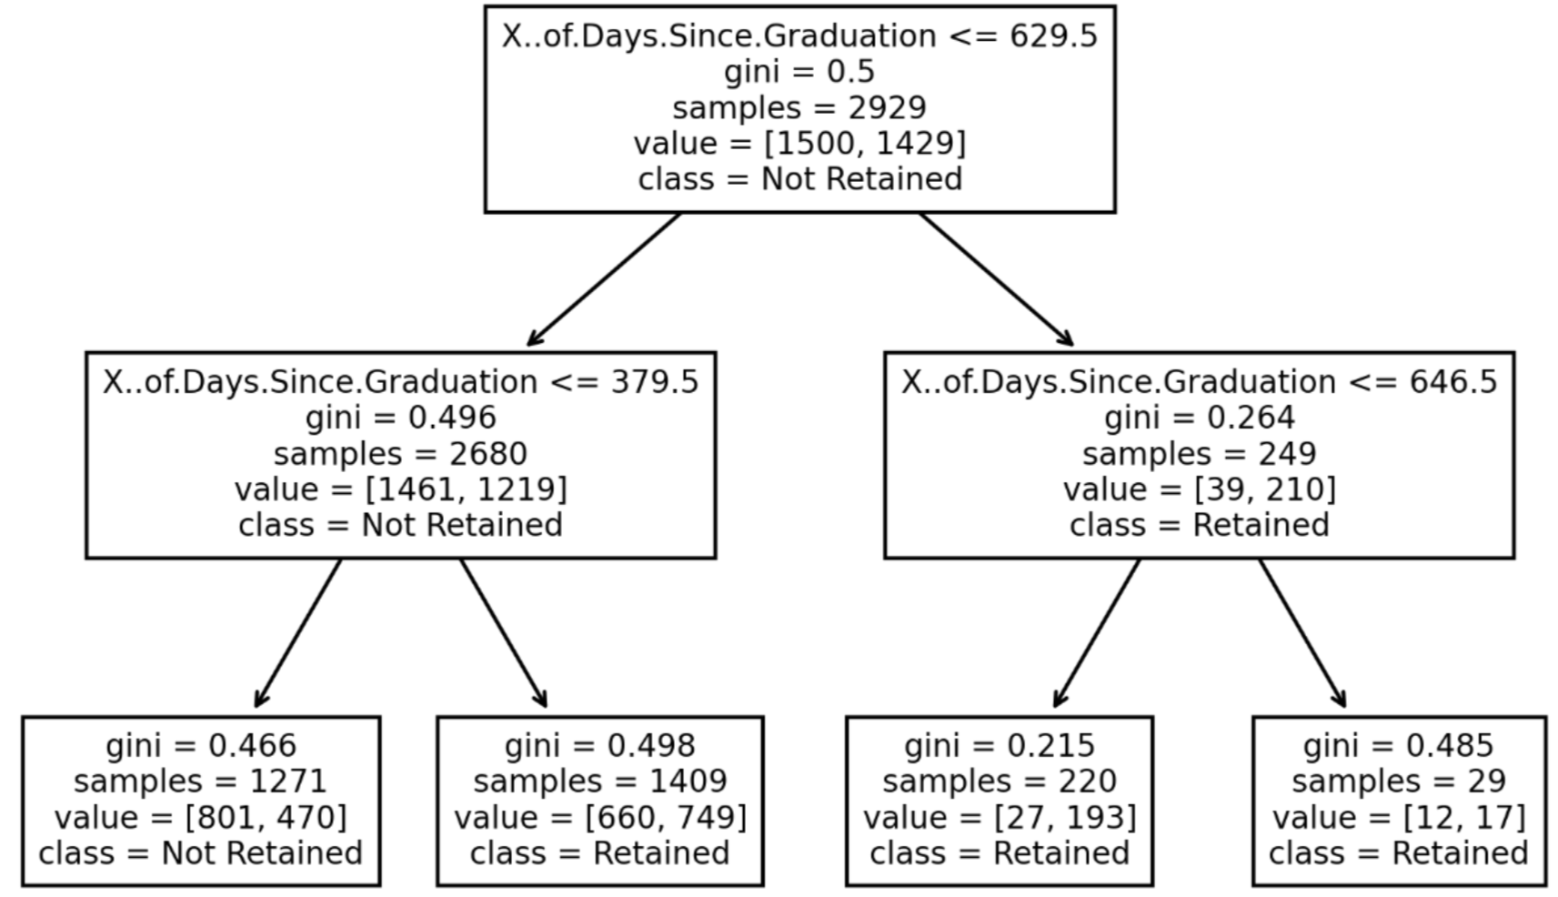
Decision Tree - Target Variable is job retention at 6 months after starting job
Notes:
SPEAKER: <name> Predicting success: Does the program make a difference? For who?

Slide 34
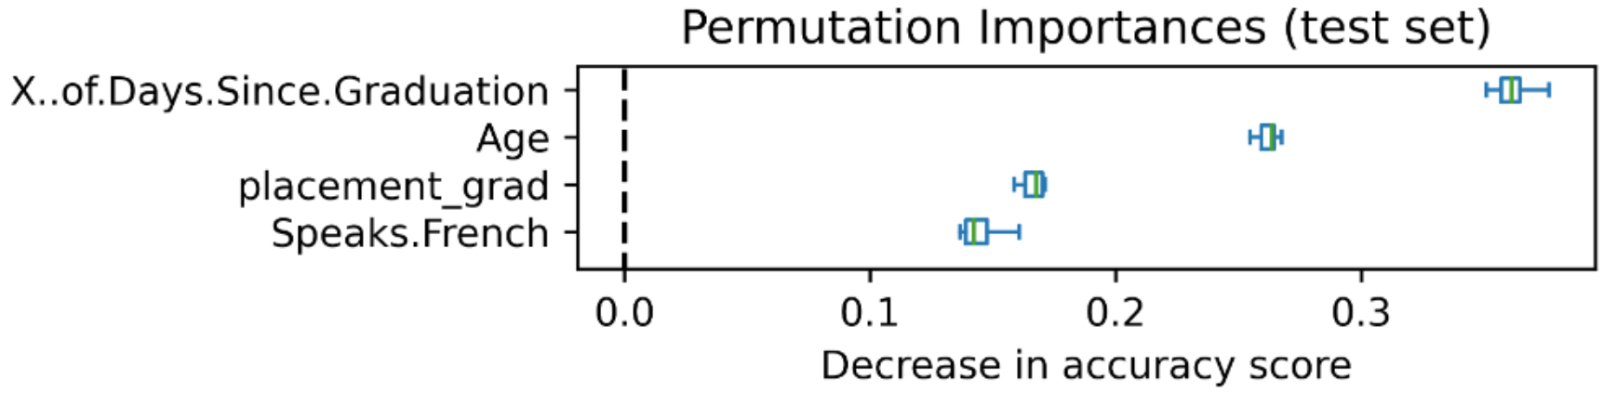
Feature Importance
Notes:
SPEAKER: <name> Predicting success: Does the program make a difference? For who?

Slide 35
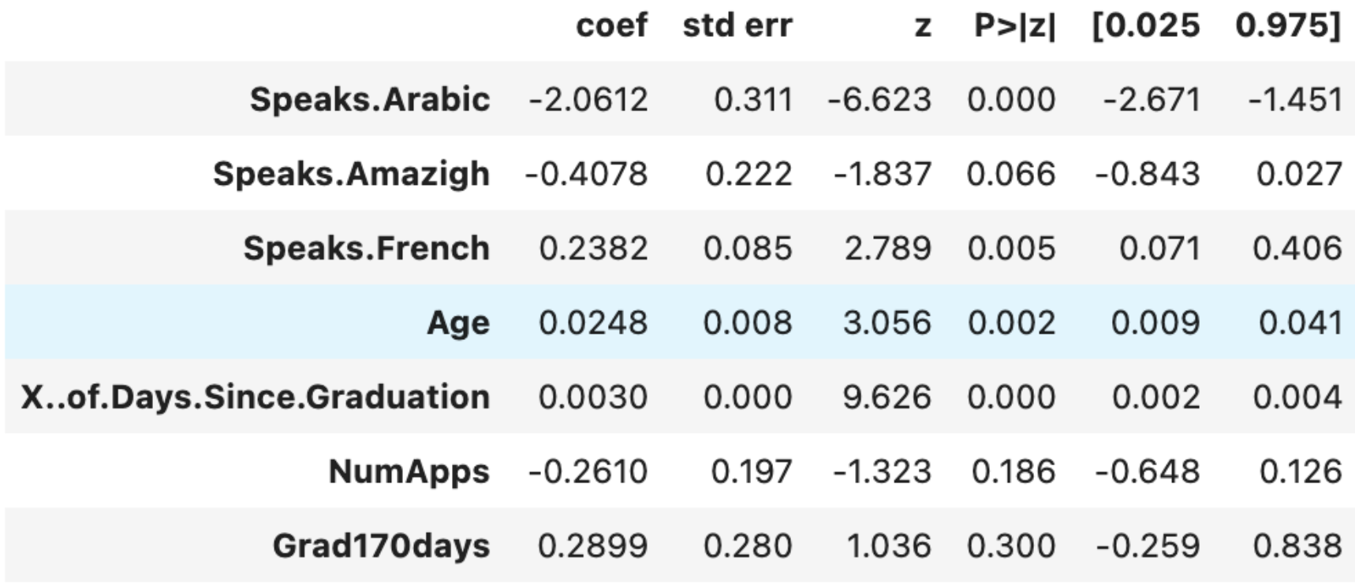
Feature Importance
Notes:
SPEAKER: <name> Predicting success: Does the program make a difference? For who?

Slide 36
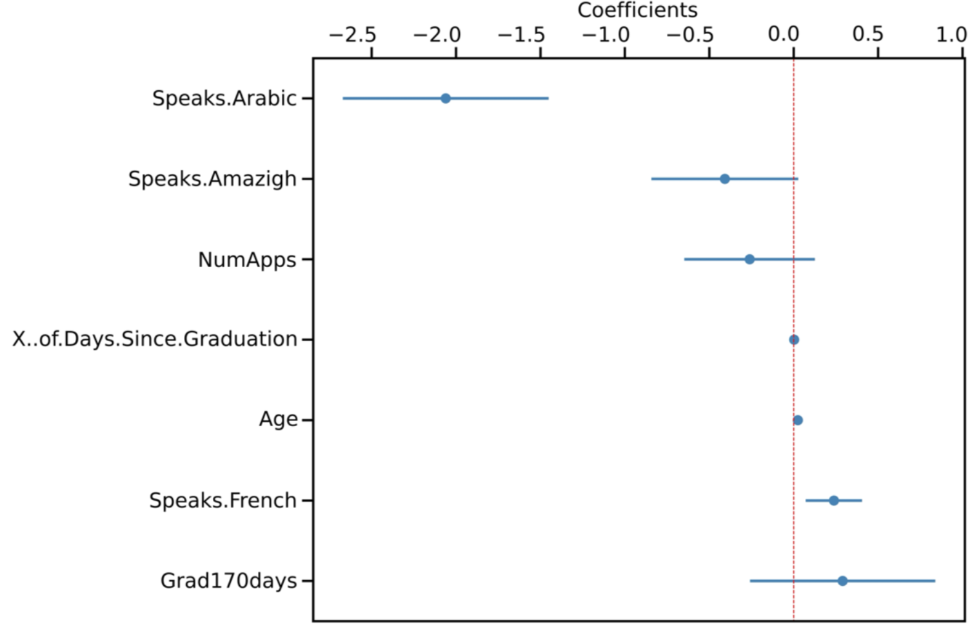
Feature Importance
Notes:
SPEAKER: <name> Predicting success: Does the program make a difference? For who?

Slide 37
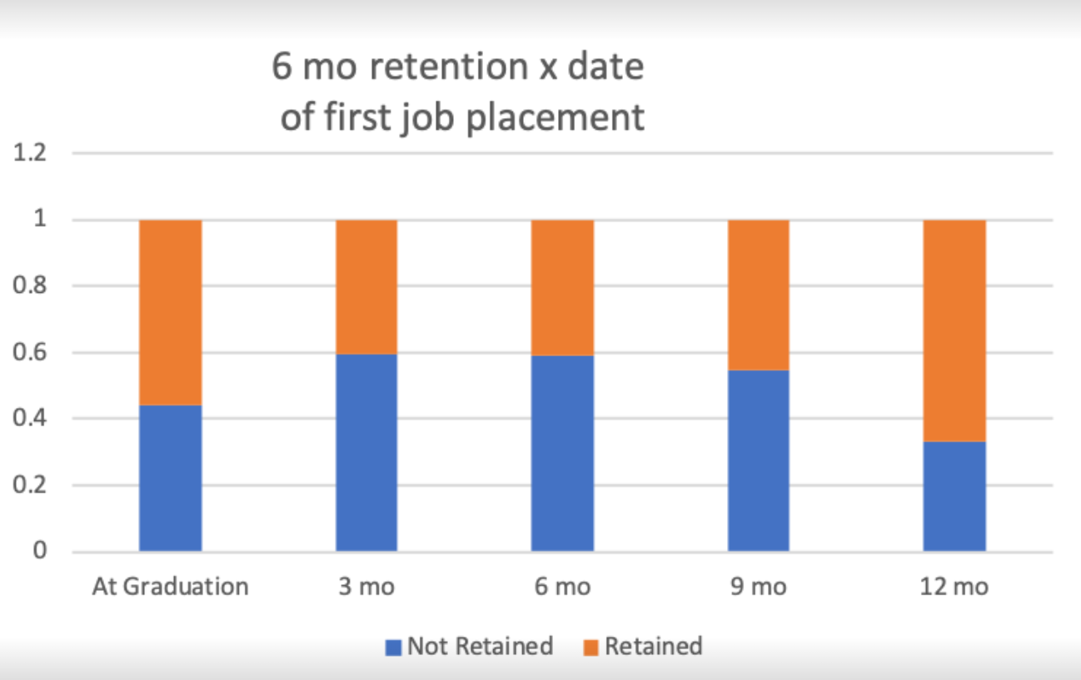
Feature Importance
Notes:
SPEAKER: <name> Predicting success: Does the program make a difference? For who?

Slide 38
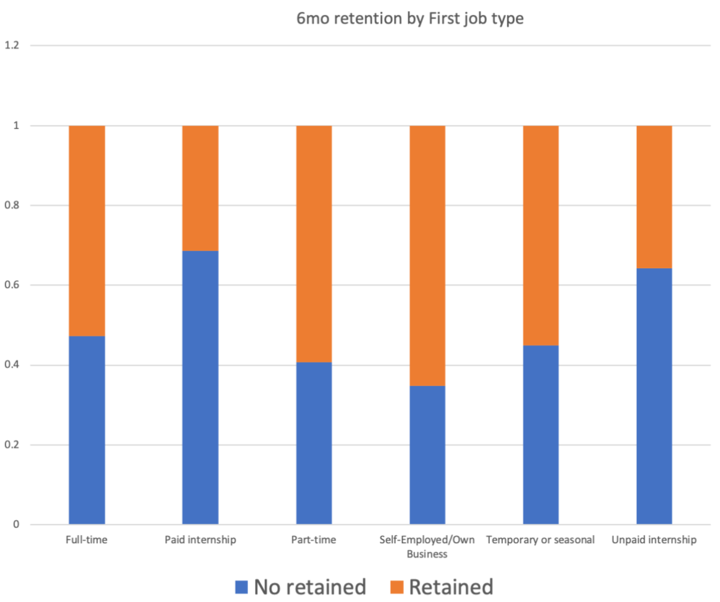
Feature Importance
Notes:
SPEAKER: <name> Predicting success: Does the program make a difference? For who?

Slide 39
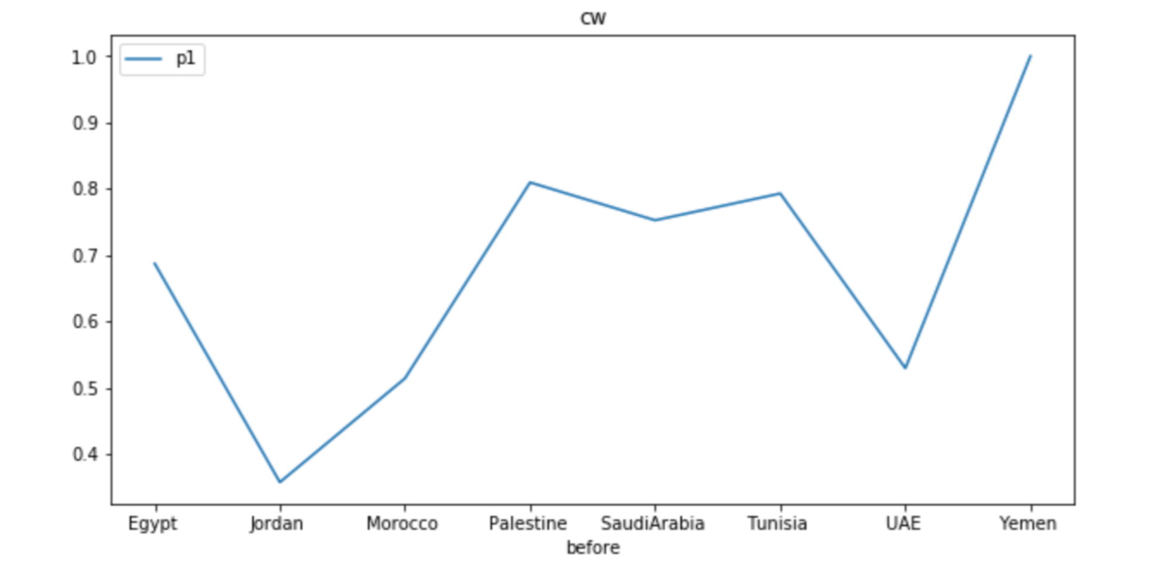
Geographical Variance
Notes:
SPEAKER: <name> Predicting success: Does the program make a difference? For who?

Slide 40
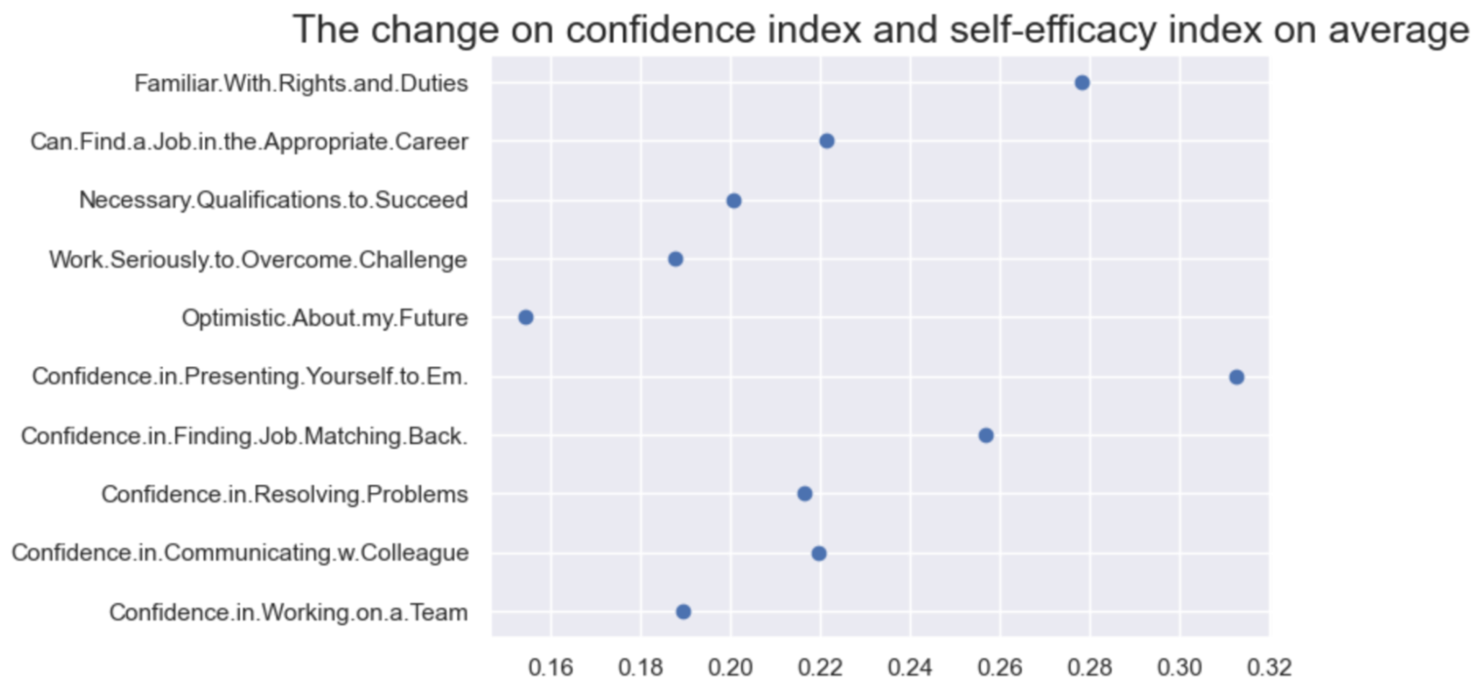
Notes:
SPEAKER: <name> Predicting success: Does the program make a difference? For who?

Slide 41



Housekeeping/Knowledge Management
Documentation Project docs are located in the Google Drive folder. Data Ambassadors will make sure you have access when we split into groups. Overviews also include links to the rest of resources. | Code Commit your code to github! Each project has its own repo; DAs will set you up with the right level of access. If you don’t know what GitHub is, don’t worry, we can help! | Data We try to avoid committing data to Github. Each of the project Google Drive folders has a data folder where the data for the project is stored (or even better - links to access from source) | Communication Share your work with the rest of the team in Slack! Each project has a Slack channel. Please join (link below). Work will continue here after today!
Notes:
SPEAKER: Rich

Slide 42
Housekeeping/Knowledge Management
Slack If you haven’t already, please join our Slack at dkdc.herokuapp.com There are channels for each of today’s projects, with the resources pinned in a post at the top. The channels are: Save the Children: #save-october-datadive Education for Employment: #educationforemployment GET Cities: #getcitieschicago Starting WIth Today: #startingwithtoday
Notes:
SPEAKER: Rich

Slide 43
Share screenshots and tweets
#DataDive
@DataKindDC
Share screenshots and tweets
#DataDive
@DataKindDC
Notes:
SPEAKER: <name>

